Slide 1

Modernizing Cafeterias: A Smart Management System
This presentation explores a new system that streamlines cafeteria operations and simplifies student billing.

Slide 2
The Problem: Inefficient and Error-Prone Cafeteria Management
Manual Processes
Lack of Real-Time Data
Traditional methods often involve paper forms, spreadsheets, and manual calculations, leading to errors and inefficiencies.
Limited visibility into student balances, purchase history, and inventory levels, making it difficult to make informed decisions.

Slide 3
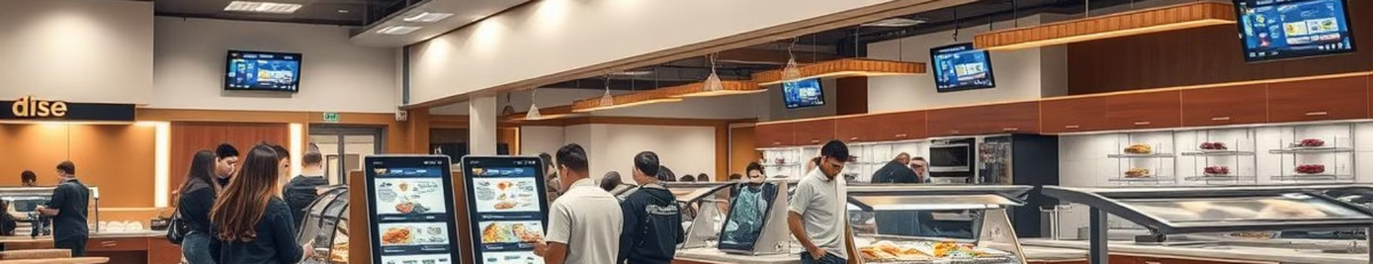
Introducing Our Solution: A Comprehensive Cafeteria Management System
Simplified Operations
Real-Time Insights
Enhanced Student Experience
Our system streamlines processes, automates tasks, and reduces manual errors.
Provides instant access to critical data, enabling data-driven decisions and improved efficiency.
Creates a smoother and more convenient experience for students with faster transactions and accurate balances.

Slide 4




Key Features:
1. Dashboard
Student Overview
Dues and Purchases
Visualize student demographics, enrollment data, and participation trends.
Track student balances, payment history, and overall spending patterns.
Inventory Management
Monitor food stock levels, order history.

Slide 5
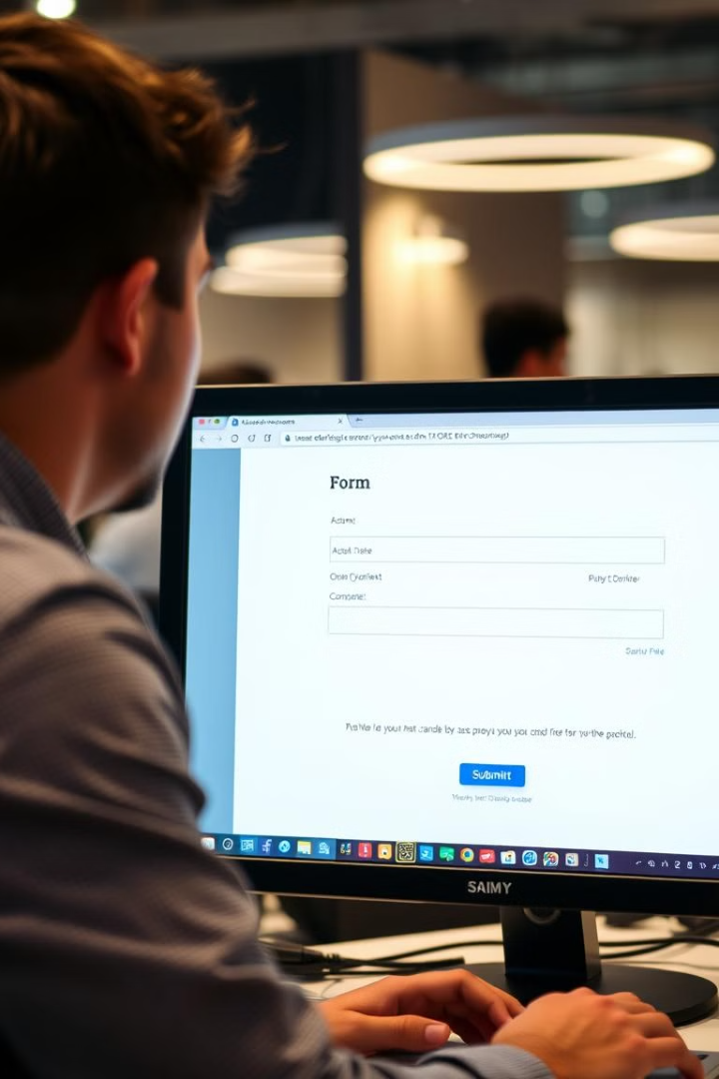
2. Student Management
Add and Update Records
Manage Balances
Effortlessly create new student accounts, update personal information, and manage student profiles.
Deposit funds, track payments, and adjust balances quickly and easily.
Access Purchase History
View detailed records of past purchases, including date, time, and items purchased.

Slide 6
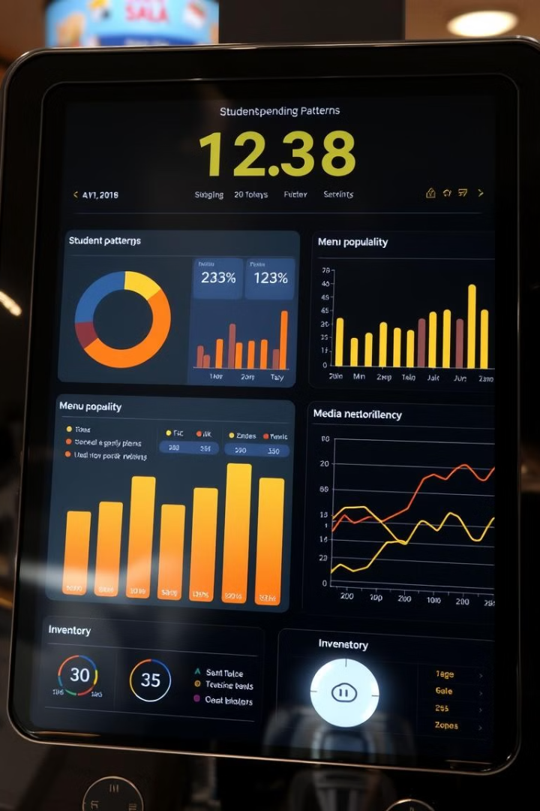


3. Reporting and Analytics
Generate Customized Reports
Create reports on student balances, spending habits, and popular menu items.
Analyze Data Trends
Identify patterns in student preferences and adjust menus accordingly.

Slide 7




Powerful Technology Stack: Next.js, Tailwind CSS, Node.js, MySQL
Next.js
1
A powerful framework for building performant and scalable web applications.
2
Tailwind CSS
A utility-first CSS framework, providing a robust and flexible design system.
3
Node.js
A JavaScript runtime environment for building server-side applications.
4
MySQL
A robust relational database management system for storing and managing data.

Slide 8
Benefits: Reduced Errors, Improved Efficiency, Real-Time Data
Accuracy
1
Eliminate manual errors by automating tasks and relying on accurate data.
Speed
2
Streamline transactions, improve wait times, and increase throughput.
Data-Driven Decisions
3
Make informed choices based on real-time insights and analytics.

